Slide 1


Social buzz

Slide 2


Today's agenda
Project recap
Problem
The Analytics team
Process
Insights
Summary

Slide 3

the study of social media has become the major research
and business practice .the environment id evolving rapidly
due to market demands and enormous application .
A comparative analysis has been carried out to judge their
suitability
Project Recap

Slide 4

over 100000 post per day
36500000 piece of content per year !
But how to capitalize on it where there is so much?
Analysis where to find social buzz top 5 most popular
category of content!
Problem

Slide 5


myself
Rishad A
Data analyst
The Analytics team
Marcus Rompton
Senior principle
Andrew Fleming
Chief technical architect

Slide 6
Process
1
Data understanding
2
Data cleaning
Data modeling
3
4
Data analytics
5
Uncover insight

Slide 7

Insights
16
Unique
categories
1897
Reactions To “Animals” Posts
JANUARY
Month with
Most posts

Slide 8
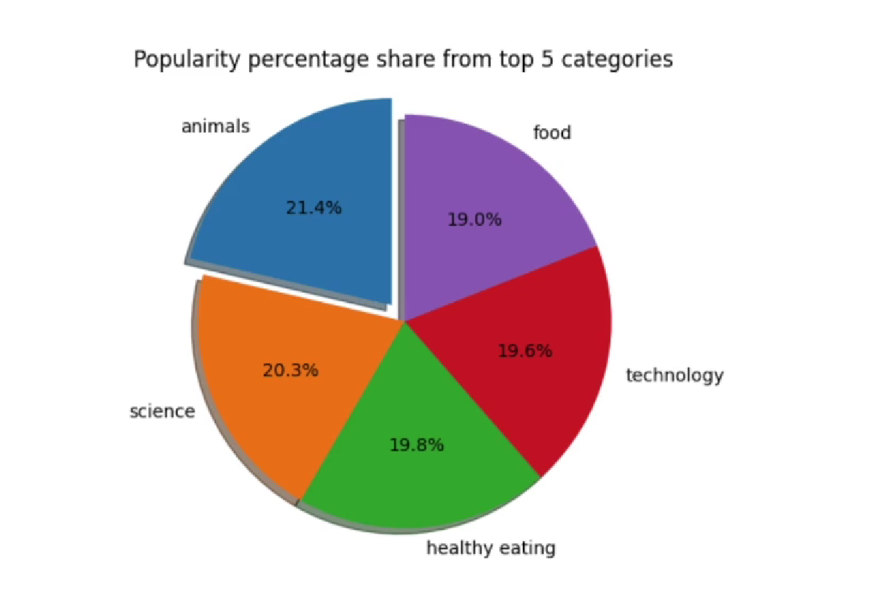

Slide 9
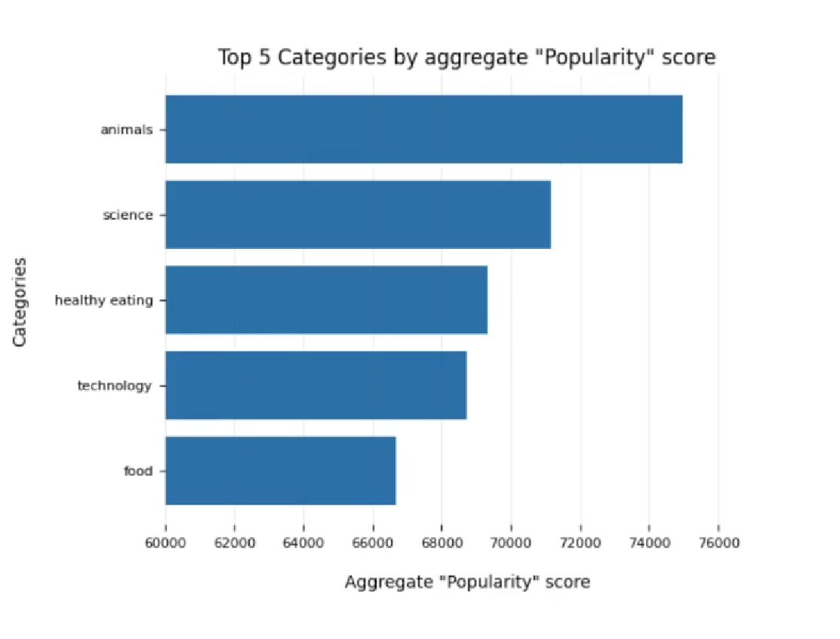

Slide 10

Analysis
Animals and science are the
Two most popular categories of content showing that people enjoy
“real-life” and “factual”
Content of the most.
Summary
Insight
Food is a common theme with the top 5 categories
With “healthy eating” ranking the highest. This may give an indication ti the audience within your user base. You could use the is insight to create a campaign and work with healthy eating brands to boosts user engagement.

Slide 11
Thank you!
ANY QUESTIONS?

